Slide 1
C++
Md. Abdur Rahman
Senior Computer Scientist
Centre for Advanced in Research in Sciences (CARS)
University of Dhaka

Slide 2
Control Statement
A program usually follow liner sequence to execute.
Statement One
Statement Two
… …
Statement N
Linear programs like these are very limited in the problems they can solve.

Slide 3
Control Statement
if-else
Switch
For Loop
While Loop
Do-While Loop
Break Statement
Continue Statement
Goto Statement
Comments

Slide 4
if statements
if statement
if-else statement
nested if statement
if-else-if ladder

Slide 5
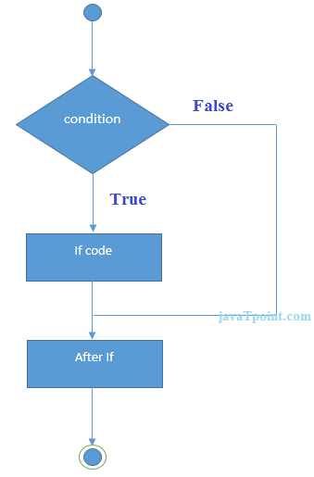
C++ IF Statement
if statement tests the condition. It is executed if condition is true.
if(condition){
//code to be executed
}
#include <iostream>
using namespace std;
int main () {
int num = 10;
if (num % 2 == 0)
{
cout<<"It is even number";
}
return 0;
}

Slide 6
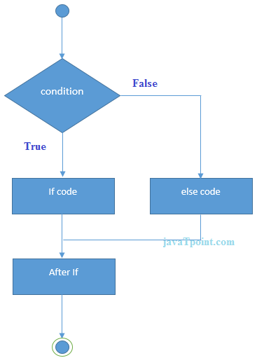
IF-else Statement
if(condition){
//code if condition is true
}else{
//code if condition is false
}

Slide 7
IF-else Statement
#include <iostream>
using namespace std;
int main () {
int num = 11;
if (num % 2 == 0)
{
cout<<"It is even number";
}
else
{
cout<<"It is odd number";
}
return 0;
}

Slide 8
If-else Example: with input from user
#include <iostream>
using namespace std;
int main () {
int num;
cout<<"Enter a Number: ";
cin>>num;
if (num % 2 == 0)
{
cout<<"It is even number"<<endl;
}
else
{
cout<<"It is odd number"<<endl;
}
return 0;
}

Slide 9
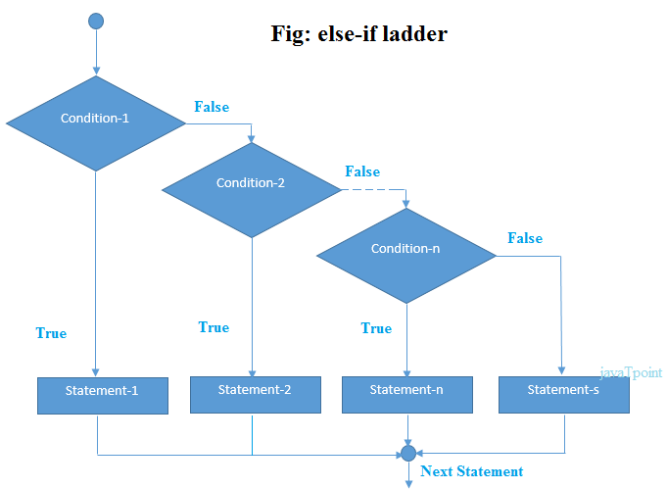
IF-else-if ladder Statement

Slide 10
IF-else-if ladder Statement
if(condition1){
//code to be executed if condition1 is true
}else if(condition2){
//code to be executed if condition2 is true
}
else if(condition3){
//code to be executed if condition3 is true
}
...
else{
//code to be executed if all the conditions are false
}

Slide 11
If else-if Example
#include <iostream>
using namespace std;
int main () {
int num;
cout<<"Enter a number to check grade:";
cin>>num;
if (num <0 || num >100)
{ cout<<"wrong number"; }
else if(num >= 0 && num < 50)
{
cout<<"Fail";
}
else if (num >= 50 && num < 60)
{
cout<<"D Grade";
}
else if (num >= 60 && num < 70)
{
cout<<"C Grade";
}
else if (num >= 70 && num < 80)
{
cout<<"B Grade";
}
else if (num >= 80 && num < 90)
{
cout<<"A Grade";
}
else if (num >= 90 && num <= 100)
{
cout<<"A+ Grade";
}
}

Slide 12
C++ switch
The C++ switch statement executes one statement from multiple conditions. It is like if-else-if ladder statement in C++
switch(expression){
case value1:
//code to be executed;
break;
case value2:
//code to be executed;
break;
......
default:
//code to be executed if all cases are not matched;
break;
}

Slide 13
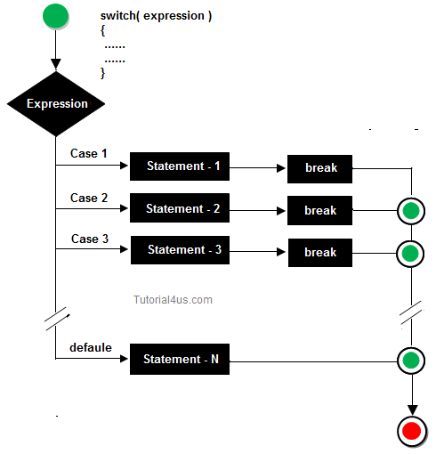
C++ switch

Slide 14
C++ Switch Example
#include <iostream>
using namespace std;
int main ()
{
int num;
cout<<"Enter a number to check grade:";
cin>>num;
switch (num)
{
case 10: cout<<"It is 10"; break;
case 20: cout<<"It is 20"; break;
case 30: cout<<"It is 30"; break;
default: cout<<"Not 10, 20 or 30"; break;
}
}

Slide 15
For Loop
The C++ for loop is used to iterate a part of the program several times.
If the number of iteration is fixed, it is recommended to use for loop than while or do-while loops.
#include <iostream>
using namespace std;
int main()
{
for(int i=1;i<=10;i++){
cout<<i <<"\n";
}
}

